Slide 1
Autonomous vehicles and silver economy
Viliam Páleník, PhD.
Institute of Economic Research, Slovak Academy of Sciences, Bratislava (Slovakia)
Autonomous Vehicles Summit, 10-11.12.2021, Bratislava
This work was supported by the VEGA 2/0150/212/0150 / 21Micro macro modeling in Slovak conditions.

Slide 2
Autonomous vehicles and silver economy
Motivation
Concept silver economy
Aging in the EU and in the world
Products of the silver economy
Innovation in the silver economy
Summary and conclusion

Slide 3
1. Motivation
autonomous vehicles:
automatic result of technological progress?
If we can do it, we do it
deeper context of changes in demand?
when we need it we do it

Slide 4
2. Concept Silver economy
A Silver Economy is understood as an adaptation of the economy for the future needs of a growing number of elderly people.
This potential is also connected with the creation of new market opportunities for the business sector.

Slide 5
3. Aging in the EU and in the world
Aging from below and from above:
Decrease in birth rates
Extending life expectancy
Babe boom - high birth rate of post-war population vintages (now retirees)

Slide 6
3. Aging in the EU and in the world
Aging:
Western Europe EU15
New Member States (EU10)
Former USSR (Russia, etc.)
Southeast Asia (Japan, Korea, Vietnam, Indonesia ...)
India
China
Non-aging:
Sub-Saharan Africa,
Islamic States
Neutral:
Latin America, USA, Canada, Australia, New Zealand

Slide 7
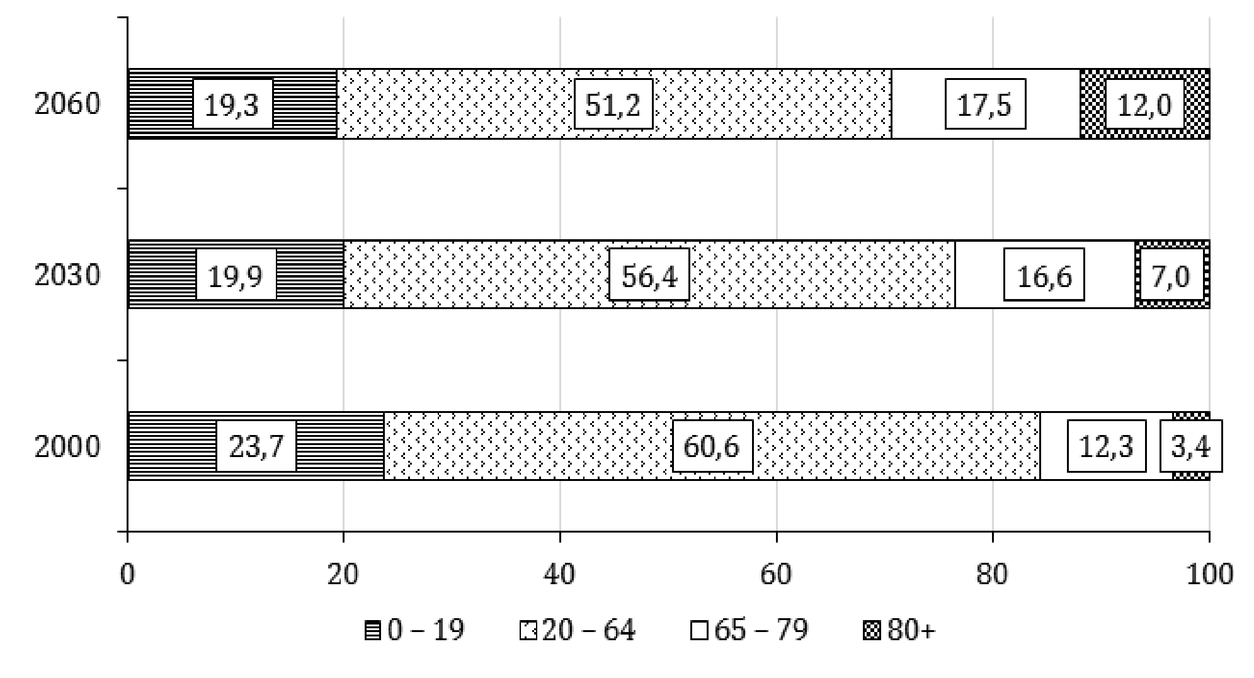
Age structure of the EU-27 population in 2000, 2030 and 2060 (in%)
Source: Year 2000 actual values according to the Eurostat database years 2030 and 2060 calculated values according to EUROPOP 2010 (proj_10c)

Slide 8
4. Products of the silver economy
Silver consumers:
in post-production age 50+):
50-64 years: young-old
65 - 79 years - old-old middle old; seniors;
over 80 years - the oldest; oldest-old or very old;

Slide 9
4. Products of the silver economy
Agriculture and food
Industry
Construction
Accommodation and food services,
Entertainment and recreationI
CT for health
Financial and insurance services
Education
Transportation
transport machines
traffic routes
other transport infrastructure

Slide 10
5. Innovation in the silver economy
New medical diagnostics
ICT technologies in long-term care
Robot as a companion of the elderly
Autonomous vehicle
etc

Slide 11
10. Autonomous vehicles and silver economy
autonomous vehicles:
automatic result of technological progress?
If we can do it, we do it - yes
deeper context of changes in demand?
when we need it we do it - yes

Slide 12
Thanks for paying attention
Viliam Páleník
Institute of Economic Research, Slovak Academy of Sciences, Bratislava , Slovakia
viliam.palenik@savba.sk www.ekonom.sav
http://www.ekonom.sav.sk/sk/publikacie/strieborna-ekonomika-v-slovenskom-europskom-a-svetovom-kontexte-p228
http://www.ekonom.sav.sk/sk/publikacie/strieborna-ekonomika-potencial-na-slovensku-p263

